Slide 1


ECEN 404
Team #44
Final Presentation
Cubesat RIOT Drive:
Ian Poynter
Joshua Feldman
Michael Kim
Alejandro Torres
Sponsor: Orbital Arc & SATOP
TA: Souryendu Das

Slide 2
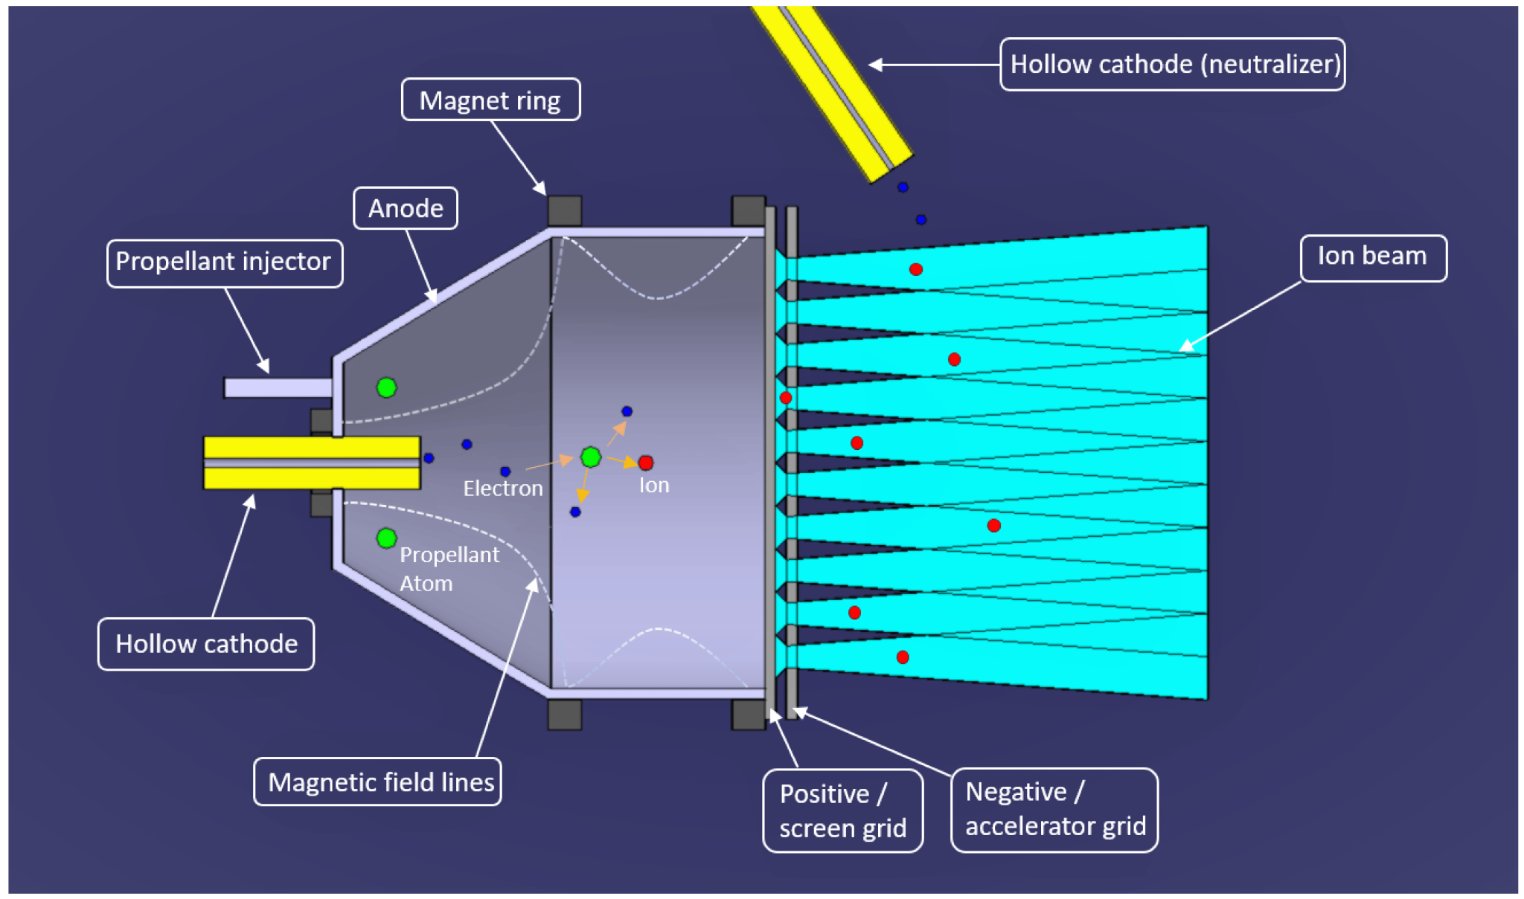
Problem Statement
Current Ion Thrusters have limited use cases due to many factors, including fuel cost and harsh ionization methods

Slide 3
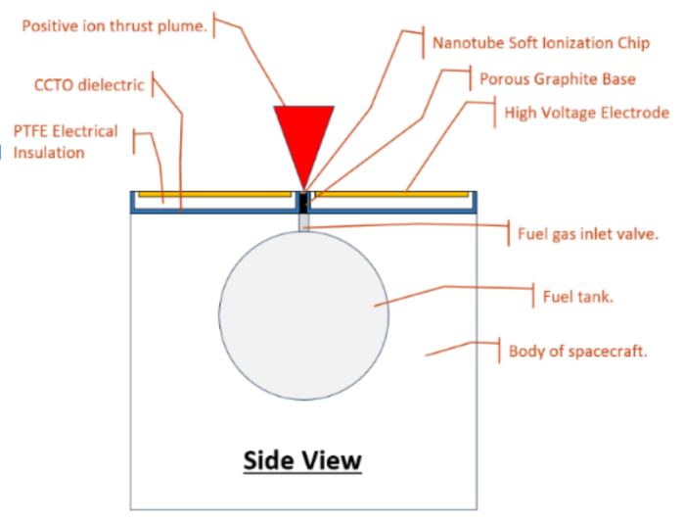
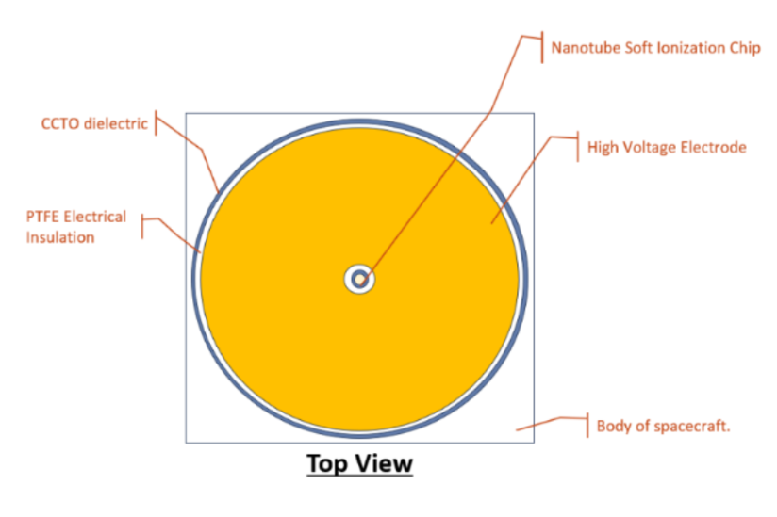
Project Summary
RIOT Drive: New type of Ion Thruster that will reduce these limitations and operate with higher efficiency
Solution
Develop a prototype for the RIOT Drive
Internal Hardware
Power Supply
Microcontroller
Accelerator Plate
Geometry Selection

Slide 4
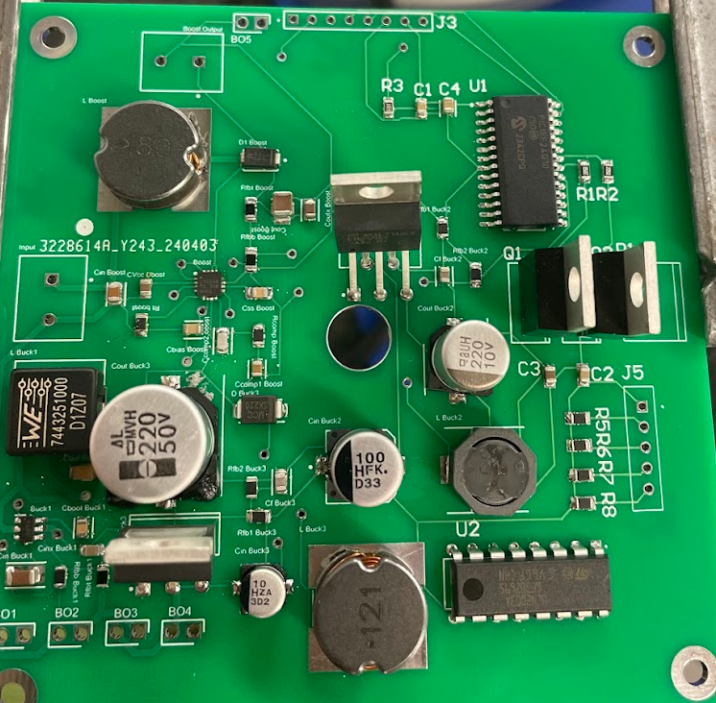
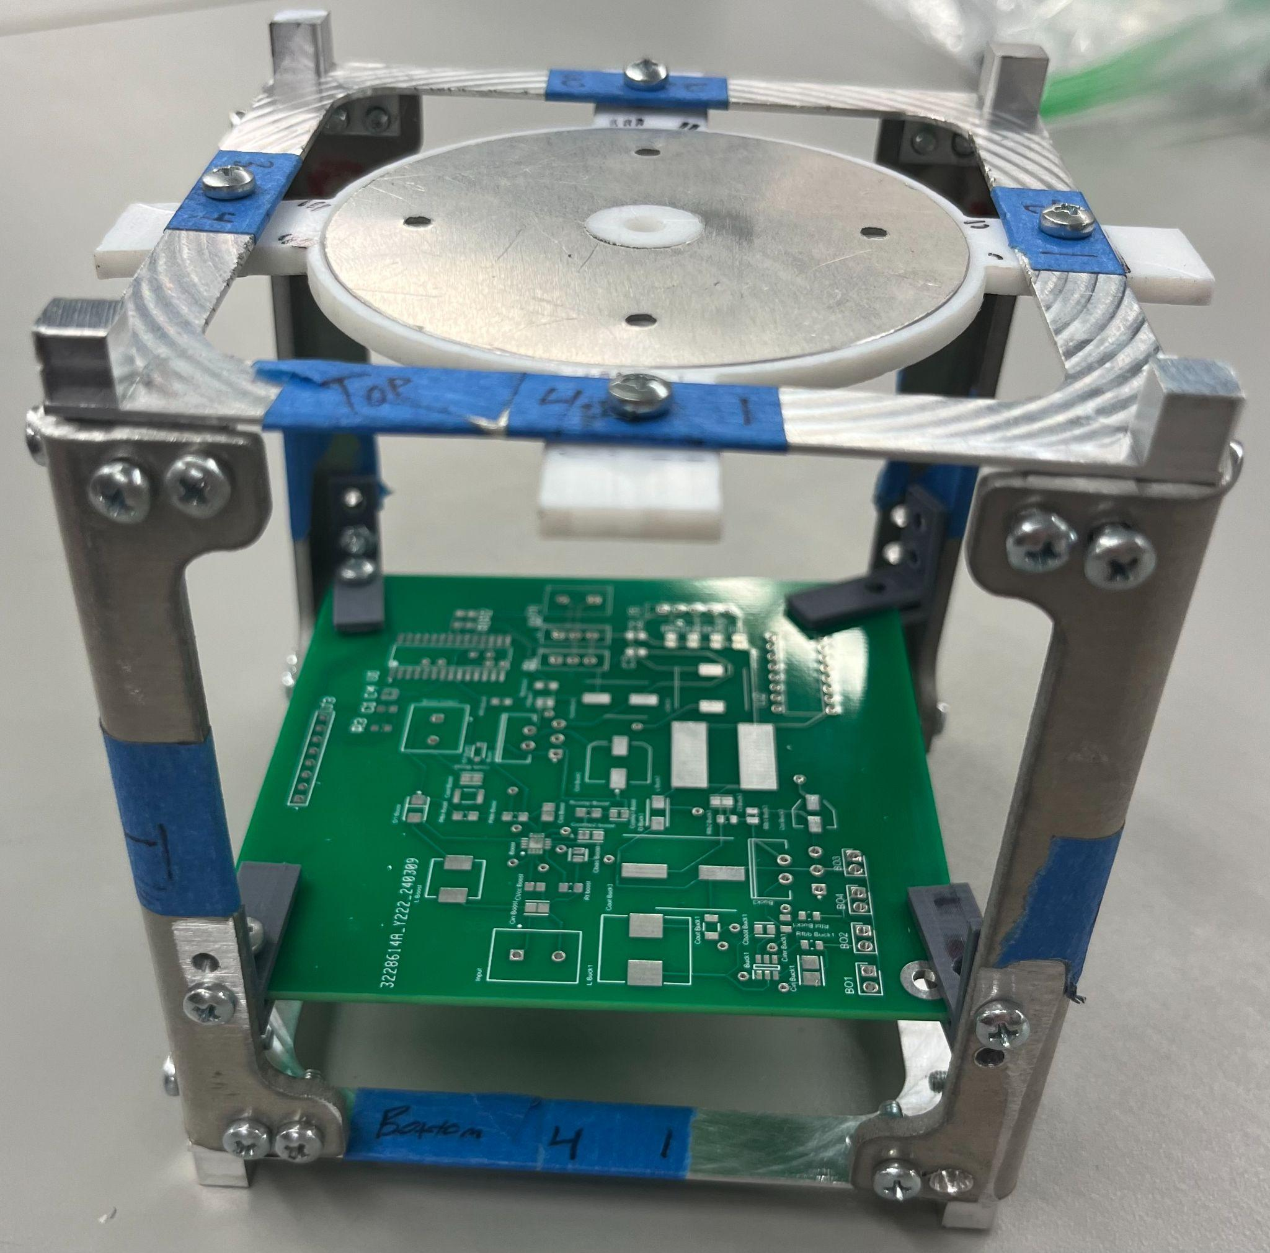
Integrated Project Diagram
Buck Converter 2
PIC MCU
Chassis
Frame
Accelerator Plate
Boost Converter
Buck Converter 1
Mounting Pieces
Integrated PCB
Buck Converter 3
Motor Driver

Slide 5
Integrated Project Diagram
Buck Converter 2
Boost Converter
PIC MCU
Buck Converter 1
Motor Driver
Buck Converter 3

Slide 6
Power Design Accomplishments
Alejandro Torres
Specification | Requirements | Results
Boost Converter | PCB boosts the input voltage to a stable 48V Voltage with a current of 0.62A. | PCB boosts input to 48.6V Output current still showing issues Still needs testing.
Buck Converter 1 | PCB bucks the 24V input voltage to 5V with Power ranging from 1-3W. | PCB converts the 24V input voltage to a 4.92V output.
Buck Converter 2 | PCB bucks the input voltage to 3.3V with a 0.35A current output. | PCB converts the 24V input voltage to a 3.28V output.
Buck Converter 3 | PCB bucks the input voltage to 5V with a 0.5A output current. | PCB converts the 24V input voltage to a 4.93V output.
Boost Converter
This Boost converter takes in 24V and outputs 48V
Buck Converter 2
This Buck Converter takes in 24V and outputs 3.3V required by the PIC18f24Q10
Buck Converter 1
This Buck Converter takes in 24V and outputs 5V required by the thermionic cathodes
Buck Converter 3
This Buck Converter takes in 24V and outputs 5V required by the stepper motor

Slide 7
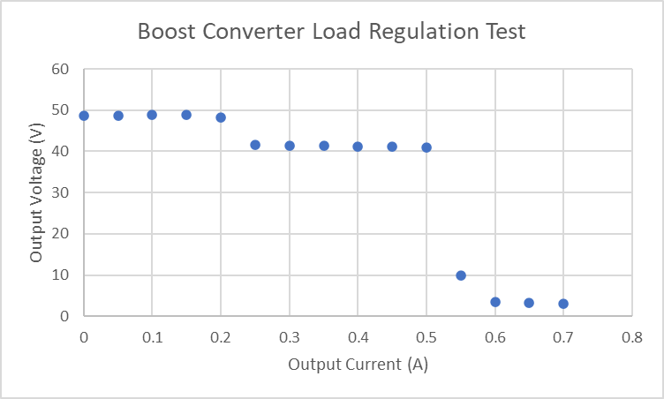
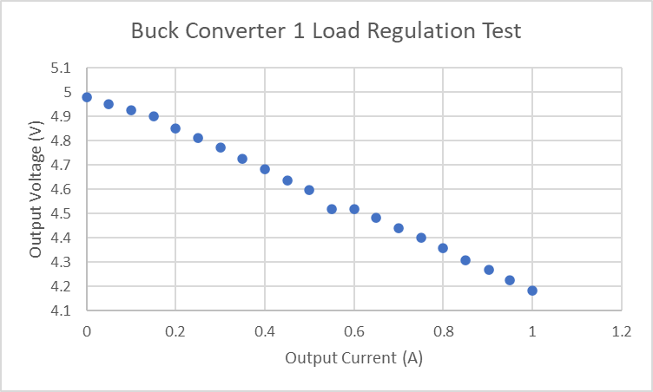
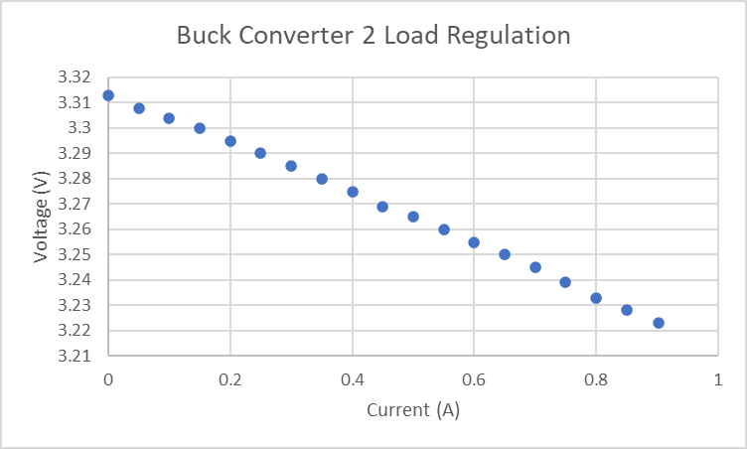
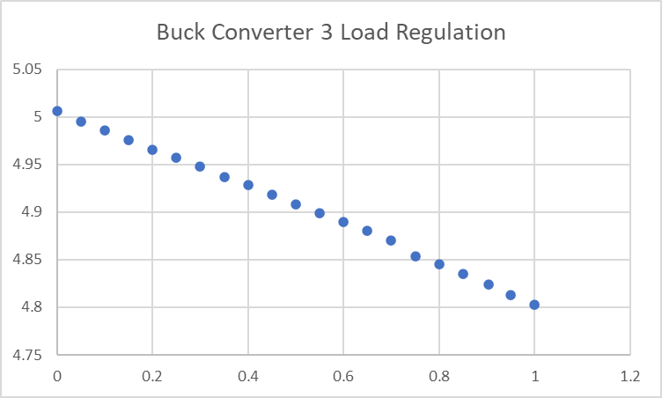
Power Design Results
Alejandro Torres
Boost Converter still has some issues when testing. A higher input current is needed to resolve this issue.
Buck Converters 1-3 all convert the input voltage to the required voltages needed for each component.

Slide 8
Power Design Challenges and Solutions
Alejandro Torres
Challenges
Issues when trying to design boost converter. Not meeting the correct output current.
MCU not working with the 5V buck converter.
Missing some components to test such as the thermionic cathodes.
Solutions
Redesigned converter, needing a higher input current than 1A.
Testing the MCU with 3.3V and then redesigning the buck converter to meet the specification to power the MCU and then finally integrating.
Load testing the converters to ensure these components receive the correct power specifications.

Slide 9
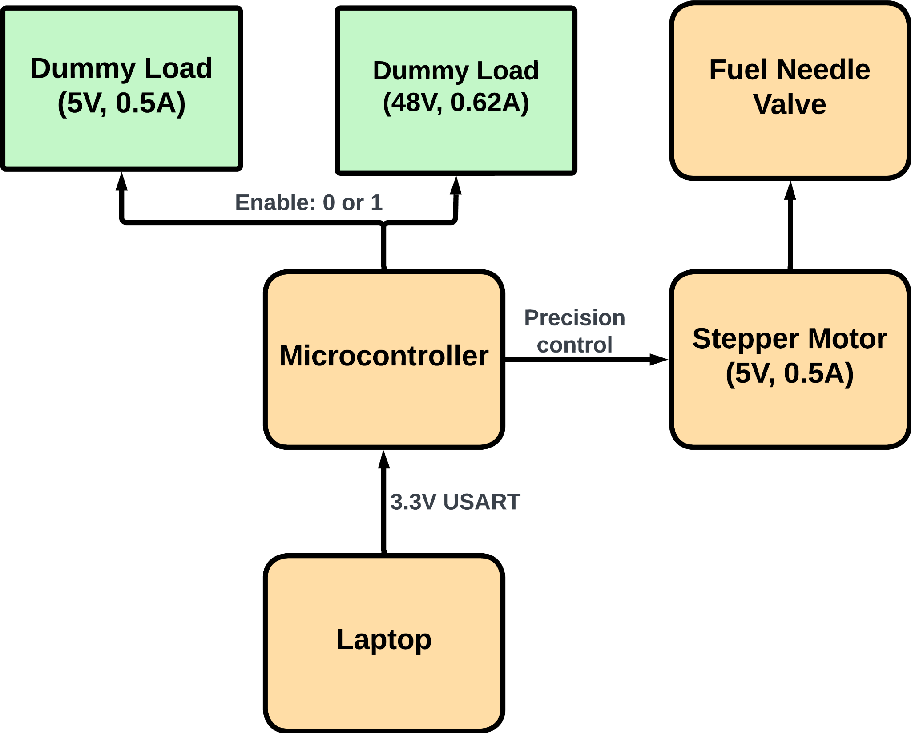
Microcontroller Flow Diagram Joshua Feldman

Slide 10
Microcontroller Board Components Joshua Feldman
Microcontroller PIC18f24Q10 microcontroller that controls prototype components.
USART & Programming connection This connection functions as both pinout to PICkit for programming and debugging, and USART command send and receive.
Stepper motor Driver
Driver receives PIC GPIO signals and drives motor for valve control.

Slide 11
Microcontroller Challenges and Solutions
Joshua Feldman
Challenges
PICkit breaking down and consuming power from circuit.
Switch from mass flow controller to stepper motor driver and manual flow valve.
Selection of components for switches for enabling dummy loads.
MPLabxIDE and PIC USART functionality outputting garbage values.
Solutions
Troubleshooting the cause of the power loss and ordering a new PICkit.
Rushed research and integration of stepper motor driver to microcontroller.
Researched current and voltage needs and selected transistor with acceptable loss.
Tested USART cable with PICkit enable to validate functionality, then with normal operation from power.

Slide 12
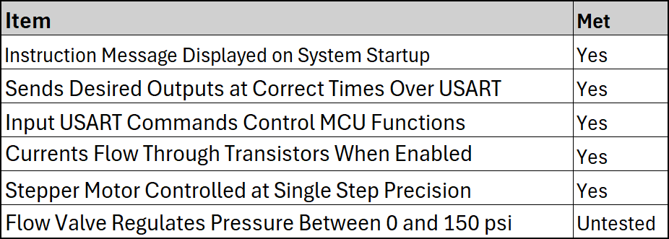
Microcontroller Results
Joshua Feldman

Slide 13
Chassis Challenges and Solutions
Ian Poynter
Challenges
Multiple subsystem objective modifications
Subsystem work outside of previous experience
Required very different skills (CAD, fabrication, design techniques, technical communication)
Solutions
Design and production of CubeSat chassis that conforms to all required specifications
Developed technical communication skills to communicate effectively with all stakeholders

Slide 14
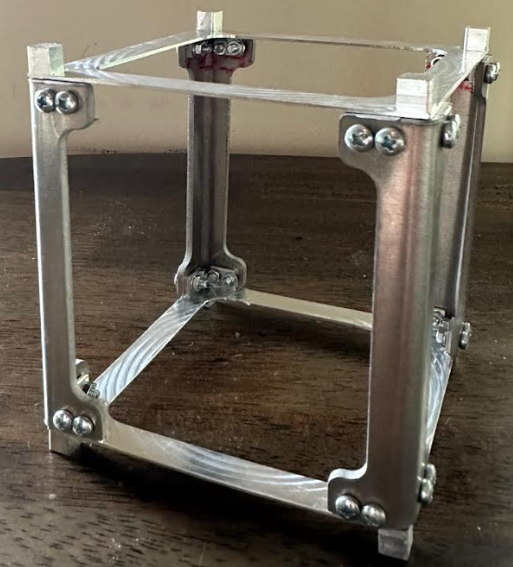
Engineering Design Accomplishments
Ian Poynter
Category | Specification | Compliance
Dimensions | 10x10x10 (cm) | ± 0.2 cm on any side
Mass | 10% of weight limit (200g) | 132 g
Rail ends | 6.5x6.5 (mm) | ± 0.1 mm
Material | Hard anodized Aluminum | Aluminum 7075

Slide 15
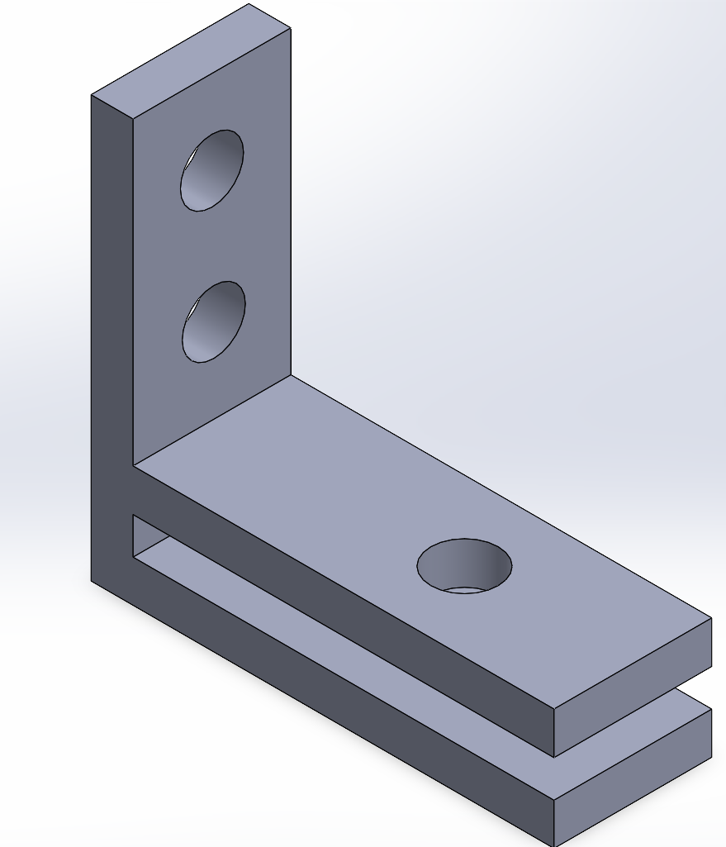
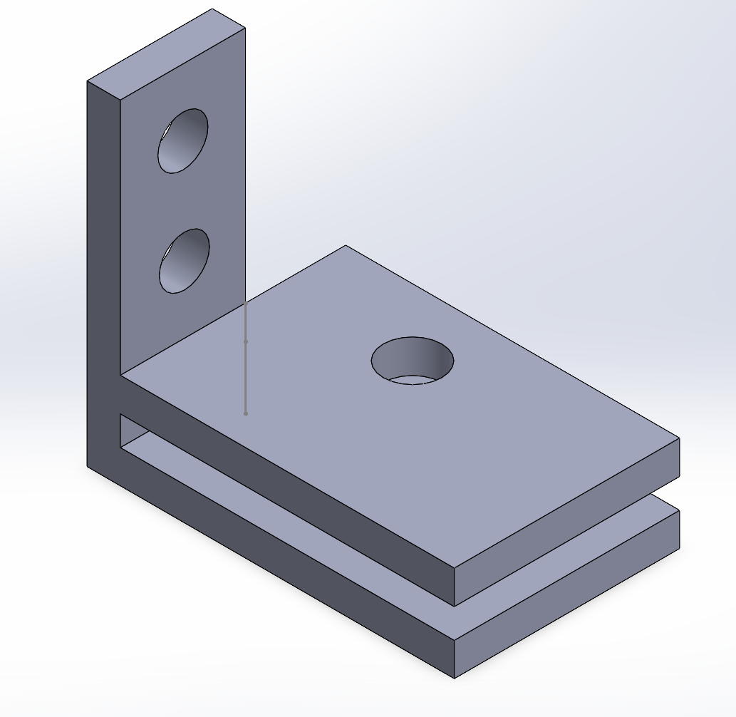
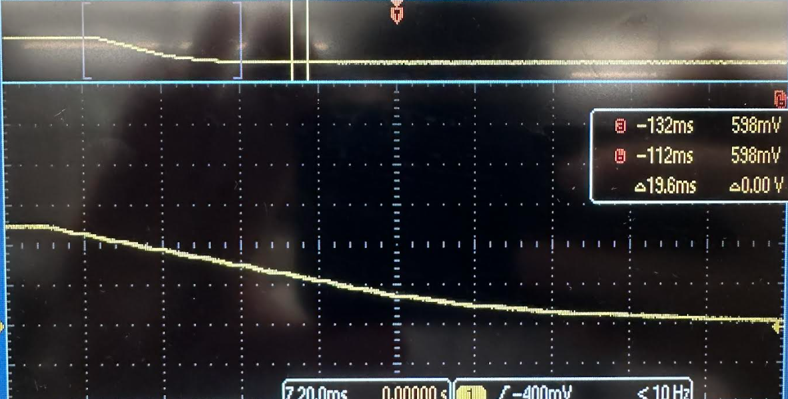
Engineering Design Accomplishments
Ian Poynter
Accelerator Plate Discharge Testing
PCB Mounting Fabrication
Design of mounting to hold PCB to Chassis
Fabrication through 3D printing
Machining of Chassis to accommodate mounting
Additional fabrication of motor-valve connector
Designed test procedure for Orbital Arc
Conducted test and reviewed results
Found linear discharge over range of operation, further testing neglected

Slide 16
Accelerator Plate Accomplishments
Michael Kim
Overview:
Geometry and Material Selection
Geometry is selected to extend electric field efficiently.
Material is selected to shield operating system.
Plate Mounting
Dimensions are determined to fit plate in chassis and be in line with PCB.
Challenges:
Input of 100 kV is too much to test physically.
Teflon has a sufficient material breakdown temperature, but has the weakest dielectric strength.
Solutions:
Simulations are done on Ansys Maxwell software.
Teflon is chosen due to almost similar dielectric values of the three tested materials.

Slide 17
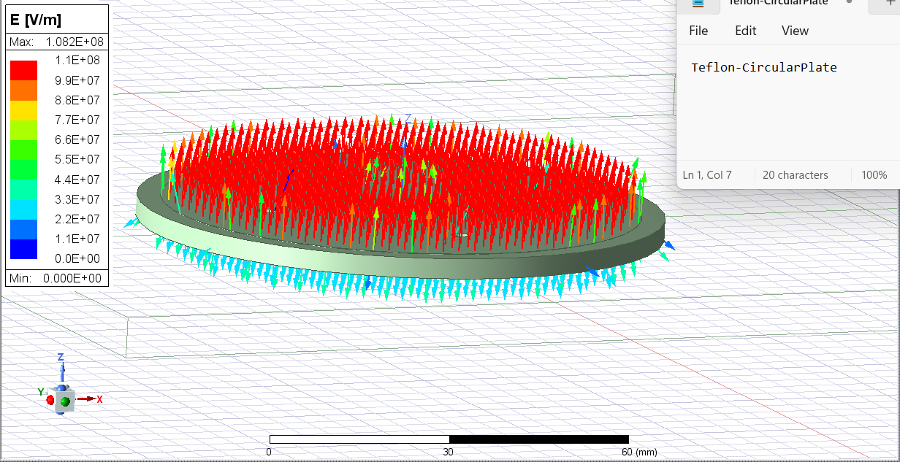
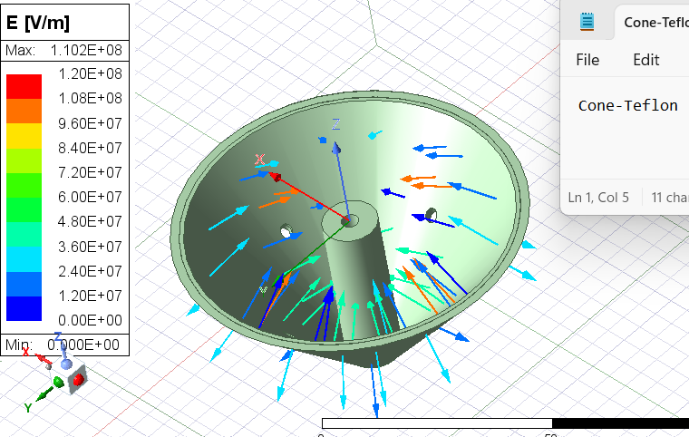
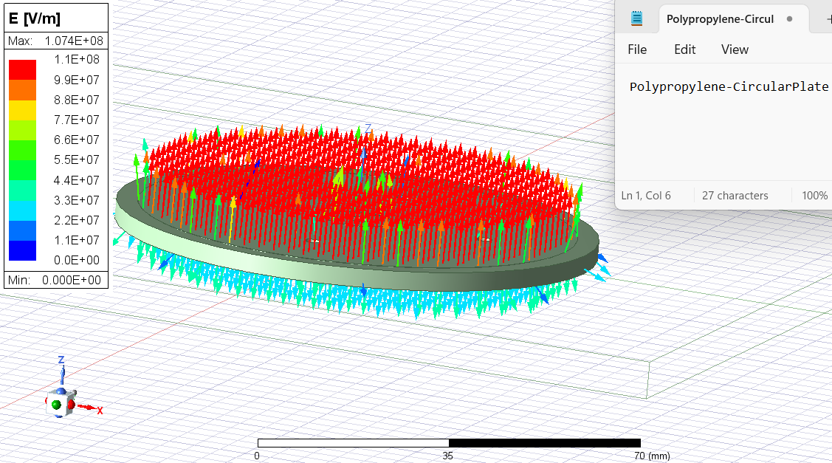
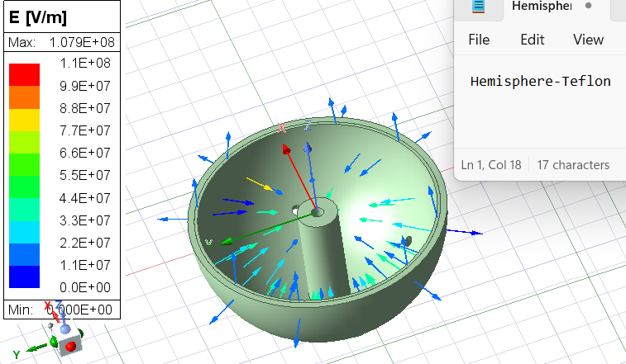
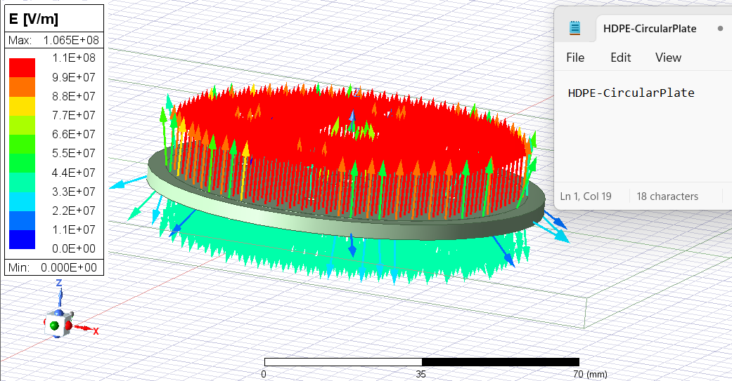
Accelerator Plate Results
Michael Kim
Higher Electric field
Lower Surface Area
Lower Dielectric Strength

Slide 18
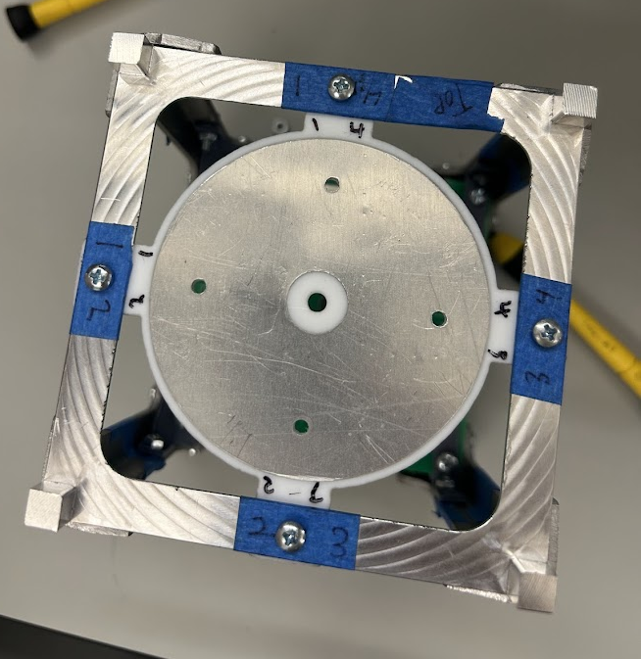
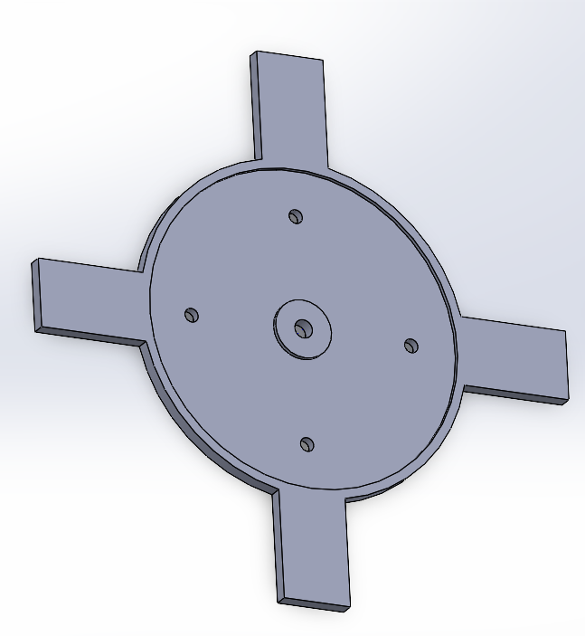
Accelerator Plate Specifications
Michael Kim
Specification | Requirement | Result
Material Breakdown | >150°C | Teflon (260°C)
Plate Selection | Whichever outputs the highest electric field | Teflon Circular-Plate
Plastic Mounting Dimensions | A sufficient diameter to fit in chassis | 74 mm (with 13 mm long prongs)
Metal Plate Dimensions | A sufficient diameter to fit in the plastic piece | 70 mm
Four holes for thermionic cathodes | 3 mm diameter with each hole 25 mm from center | Fabricated (Thermionic cathodes neglected)
Middle hole for ionizer | 4 mm diameter, and for the hole to be in line with PCB | After mounting, hole is in line.

Slide 19
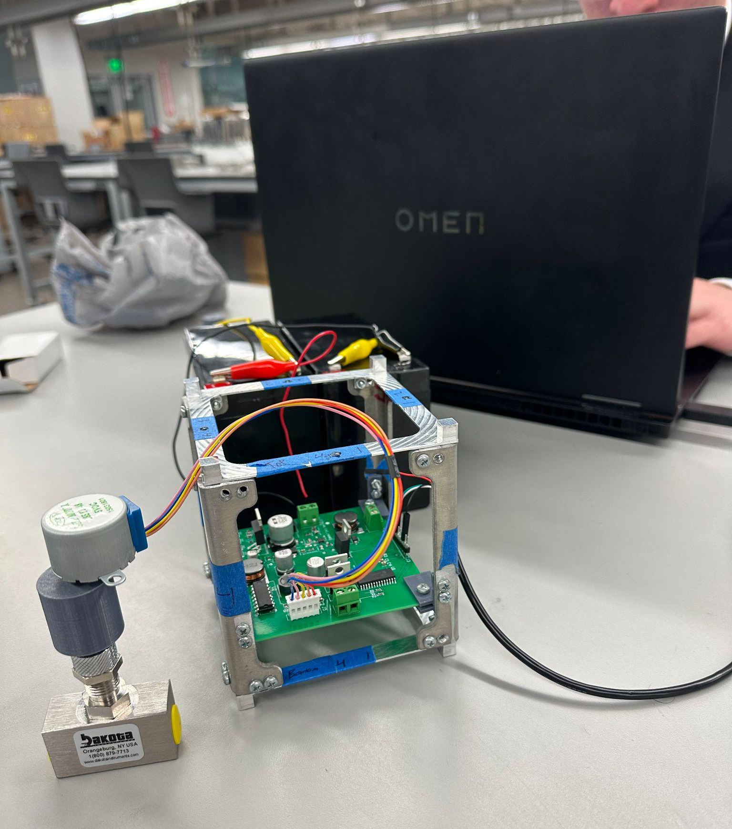
Integrated System Results
MCU functioned properly when connected with the integrated PCB and the DC power supply.
Stepper motor control functioned properly with the integrated PCB.

Slide 20
Conclusions
Challenges:
Some components missing or in development, unable to fully test.
Changing the boost converter to output 48V instead of 33V.
Inability to perform high voltage testing.
Switch from mass flow controller to manual mass flow valve removed ADC and DAC from microcontroller and added stepper motor driver.
Current Status:
Testing PCB with two 12V batteries and load testing boost converter with higher current.
Waiting for air compressor to test gas flow valve.

Slide 21

Thank you!

